Slide 1
Login
Triple C FC
RL Football Team
Final project on Google Research Football
차정엽
최이솔
최진성

Slide 2
Content
Login
Introduction
Limitation
- Google Research Football environment
- Physical limitation
Strategy
- Technical limitation
- Challenging environment
- Our team settings / idea
Follow-up
Implementation
- Imitation learning
- Custom feature extractor
- Self-play
- Action shaping
- Multi-agent
- Reward shaping
Acknowledgement
- Training method
Results
- Triple C FC

Slide 3
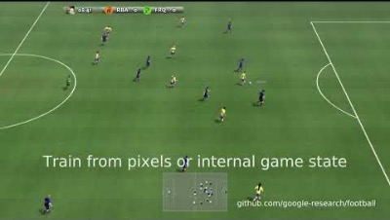
Introduction
EE488 AI Convergence Capstone Design

Slide 4
Introduction
EE488 AI Convergence Capstone Design
We wanted our environment to be…
Game we enjoyed to play
Game that includes strategical behavior
Game with multiple aspects we can modify
Challenging environment!

Slide 5
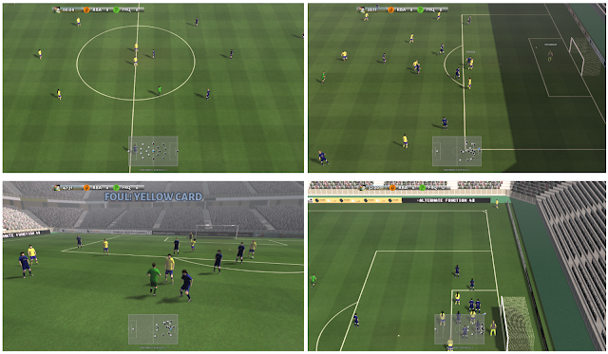
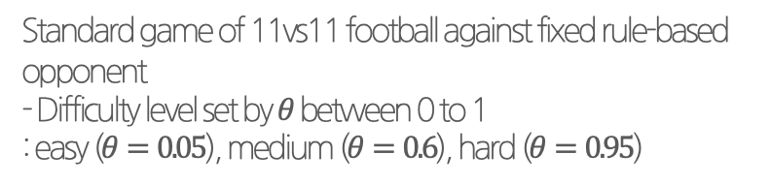
Introduction
EE488 AI Convergence Capstone Design
Google Research Football environment
3D Football simulation
Football engine
Football benchmark
Standard game of 11vs11 football against fixed rule-based opponent
- Difficulty level set by $θ$ between 0 to 1
: easy ($θ=0.05$), medium ($θ=0.6$), hard ($θ=0.95$)
Football academy
Diverse set of scenarios of varying difficulty
Ex) empty goal, pass and shoot with keeper, counter-attack

Slide 6
Introduction
EE488 AI Convergence Capstone Design
Google Research Football environment
Characteristic
Stochastic
Multi players / Multi-agent
Randomness in both the environment and opponent AI actions
11 different players following the policy when active
Can control number of players following the policy simultaneously

Slide 7
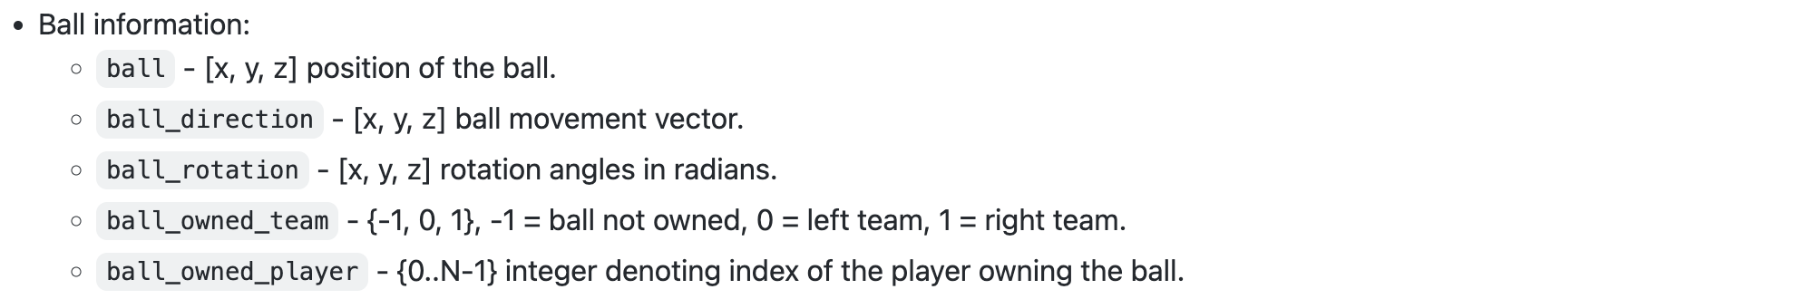
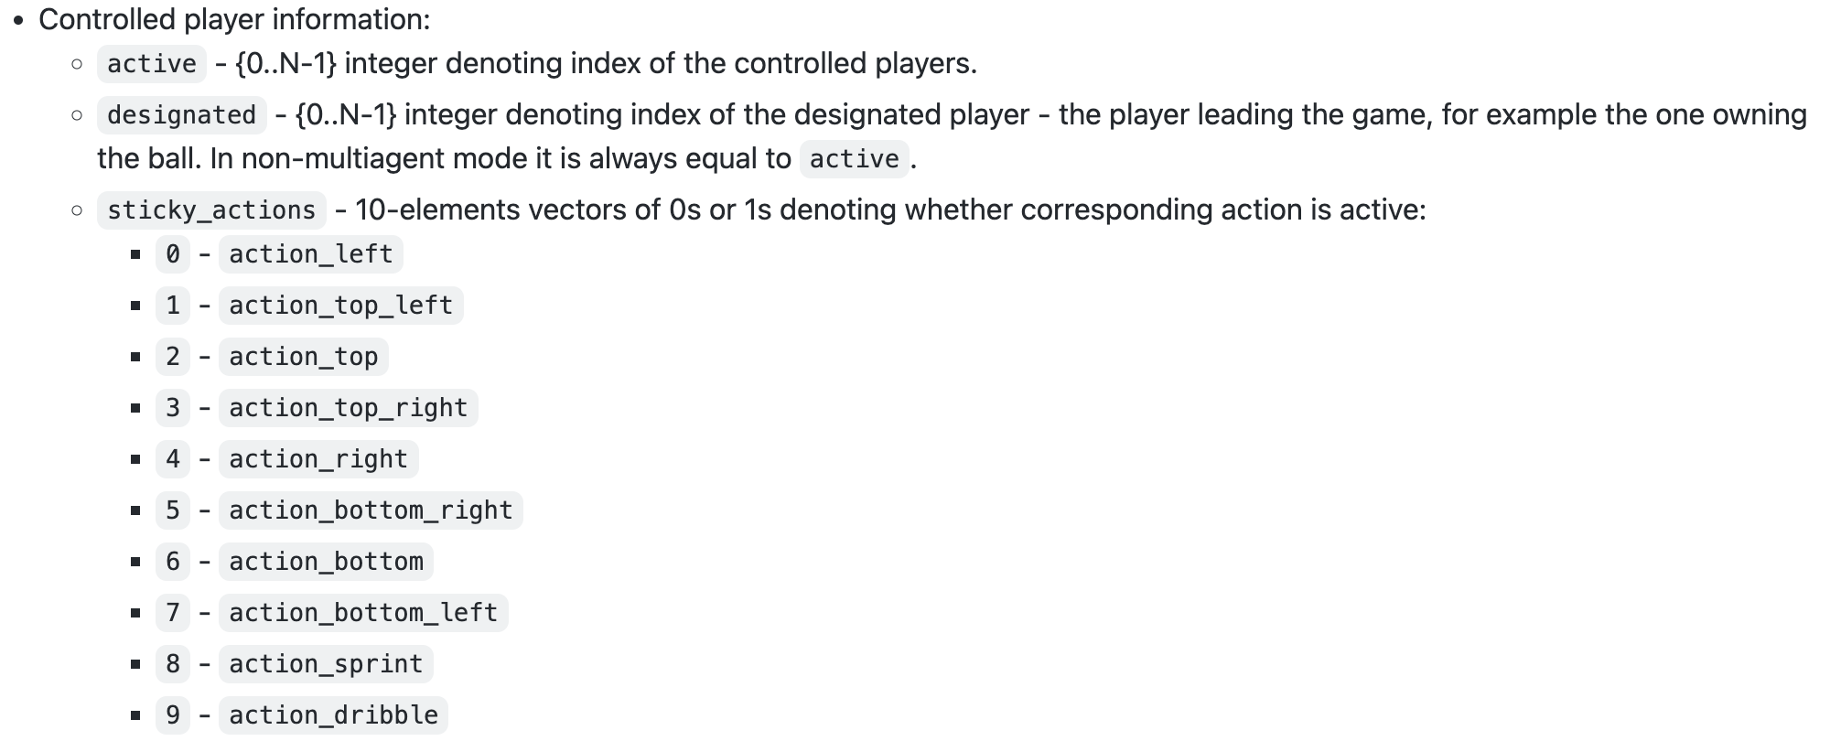
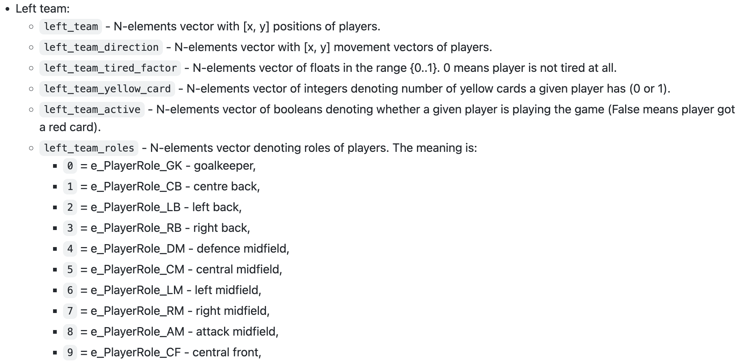
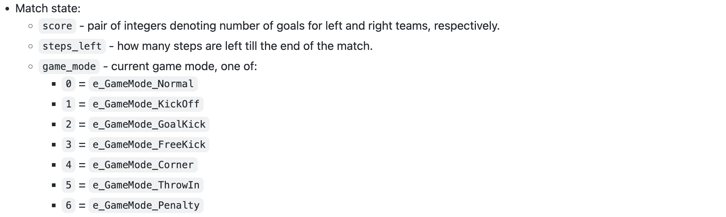
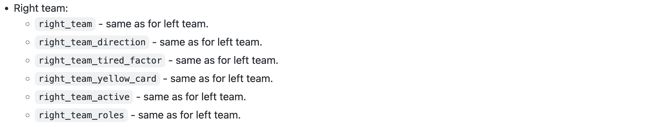
Introduction
EE488 AI Convergence Capstone Design
Raw Observation
Wide variety of information!

Slide 8
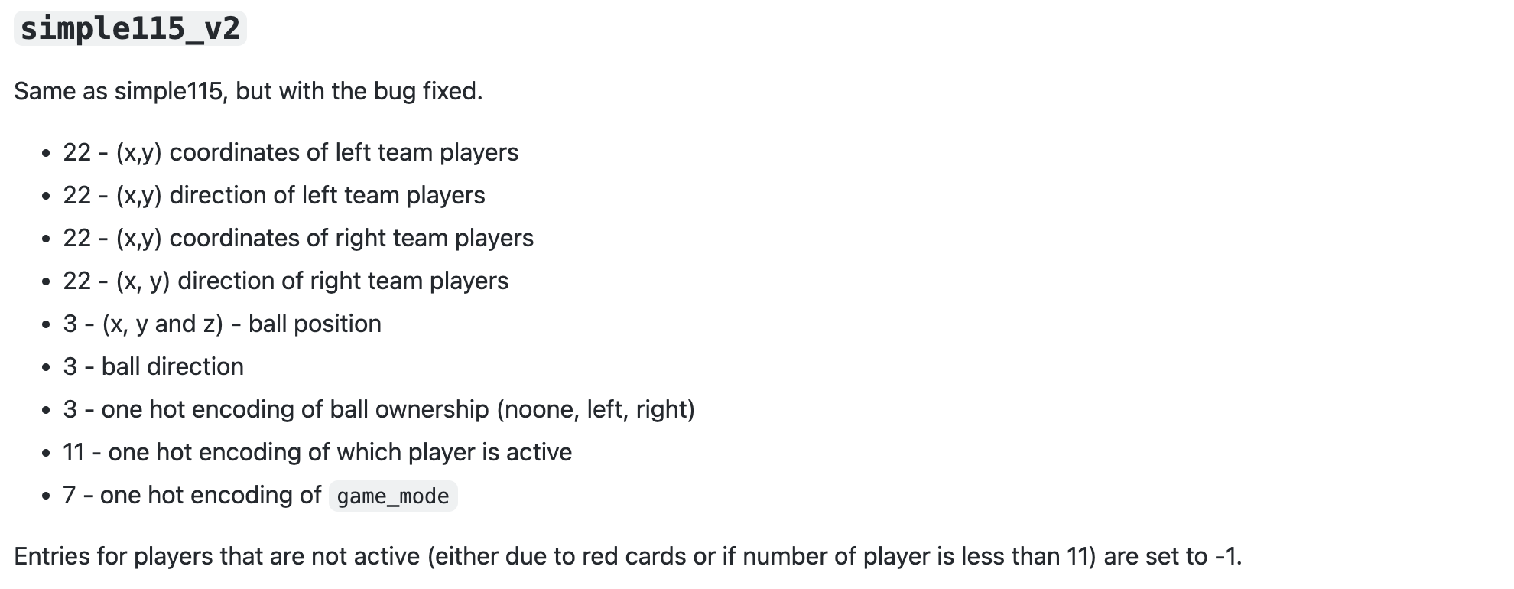
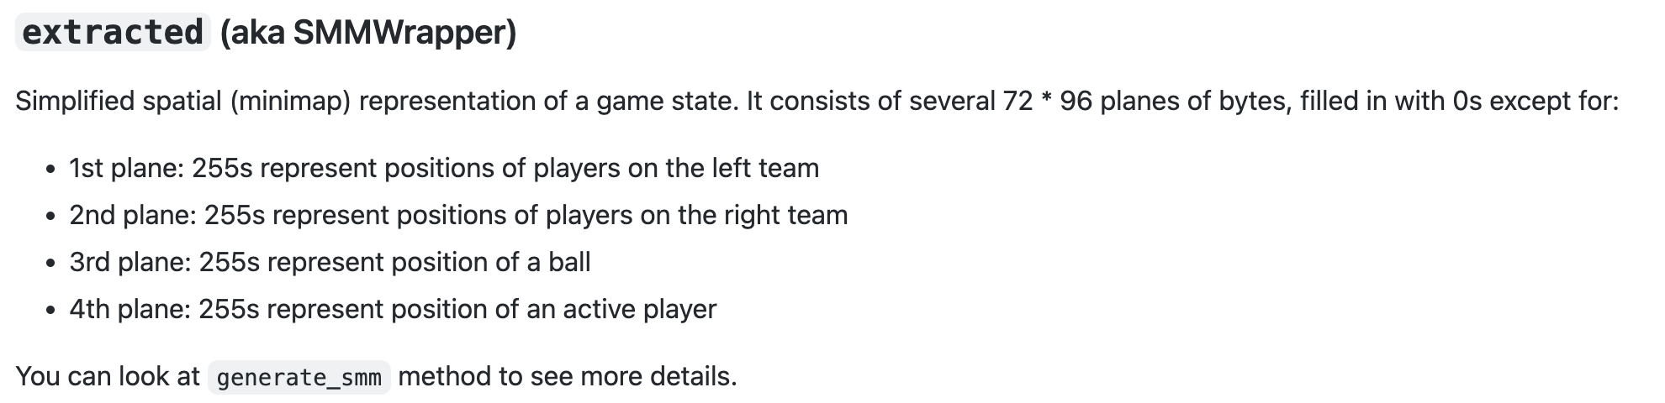
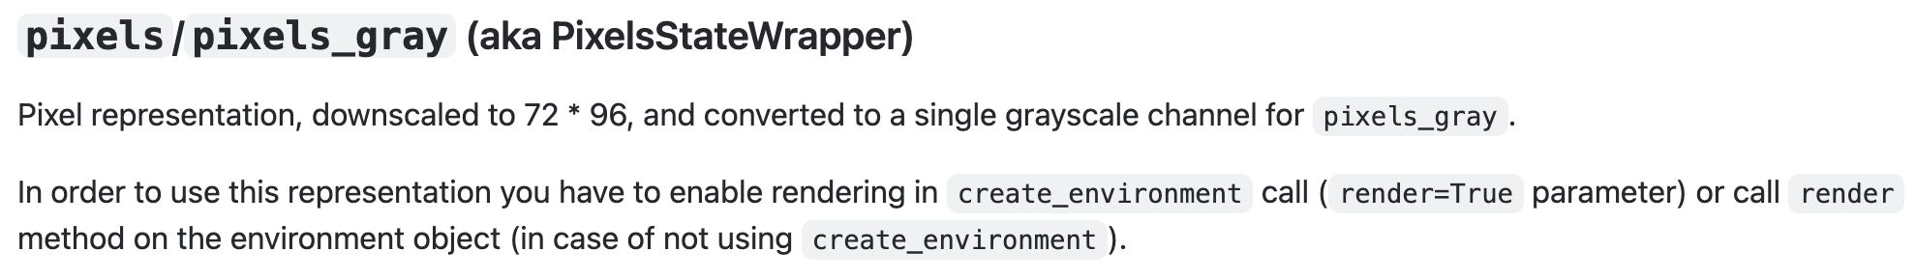
Introduction
EE488 AI Convergence Capstone Design
Observation Wrapper
Multiple wrappers we can choose!

Slide 9
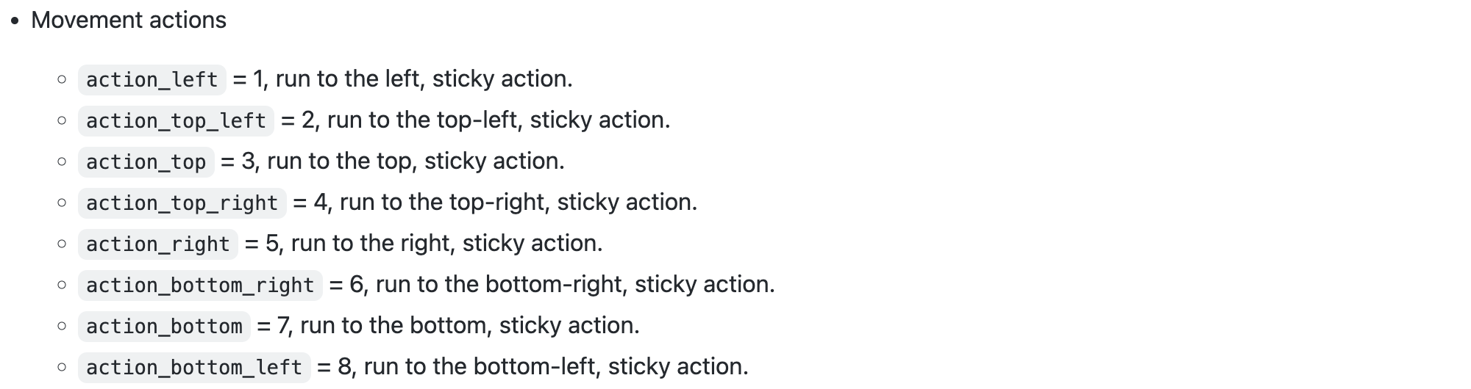
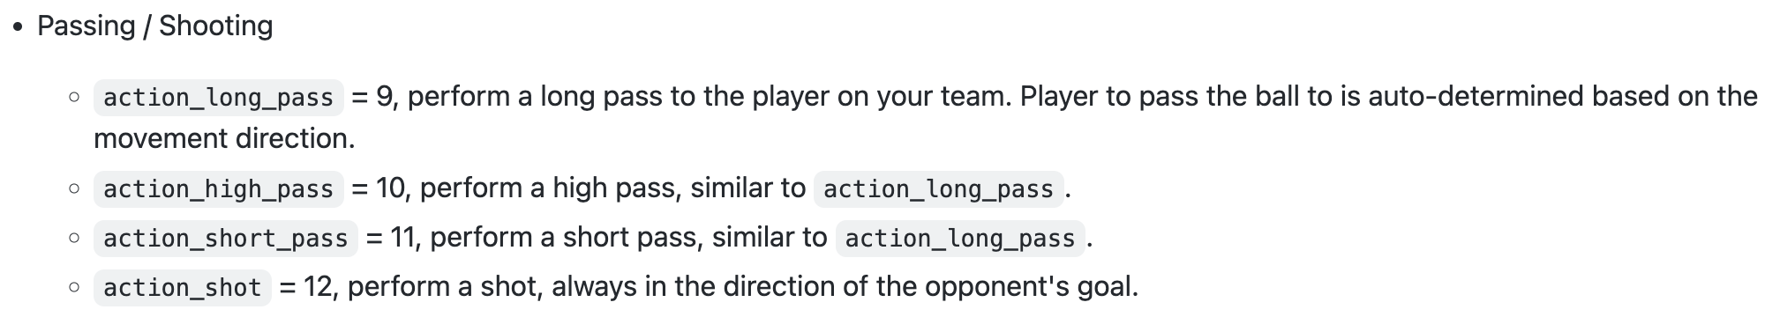
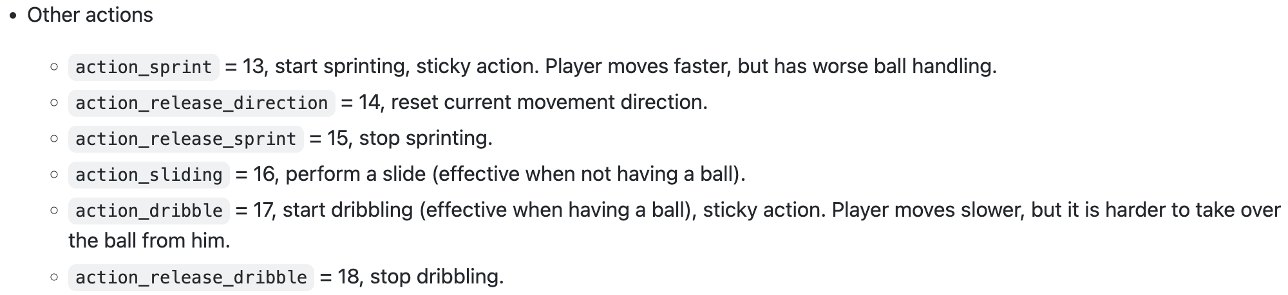
Introduction
EE488 AI Convergence Capstone Design
Action Space
Large action pool!

Slide 10
Introduction
EE488 AI Convergence Capstone Design
Default reward
Scoring
Checkpoint
Each team obtains a +1 reward when scoring a goal,
and a -1 reward when conceding one to the opposing team
Dividing opponent’s field in 10 checkpoint regions to the opponent goal.
First time the agent’s team possesses the ball in each of the checkpoint regions, obtains an additional +0.1 reward
Non-collected checkpoint reward also added when scoring
Need more reward to deal with sparsity!

Slide 11
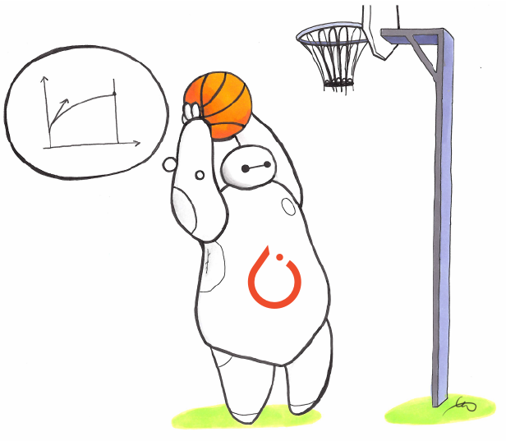
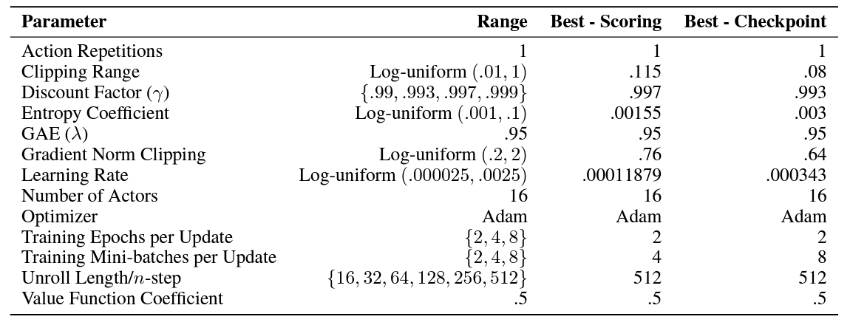
Strategy
EE488 AI Convergence Capstone Design
Our team setting
SB3
No self-play, no multi-agent
Observation space
Stacked(4 frames)
Algorithm / hyperparameter
PPO algorithm

Slide 12
Strategy
EE488 AI Convergence Capstone Design
Our team idea
Custom feature extractor
Created custom feature extractor based on the architecture of Google Research team
Action shaping
Induce the agent to perform necessary action among large pool of actions
Reward shaping
Proper rewards for the agent to feed from
Training method
Exceptional training method to induce strategical movement from the agent

Slide 13
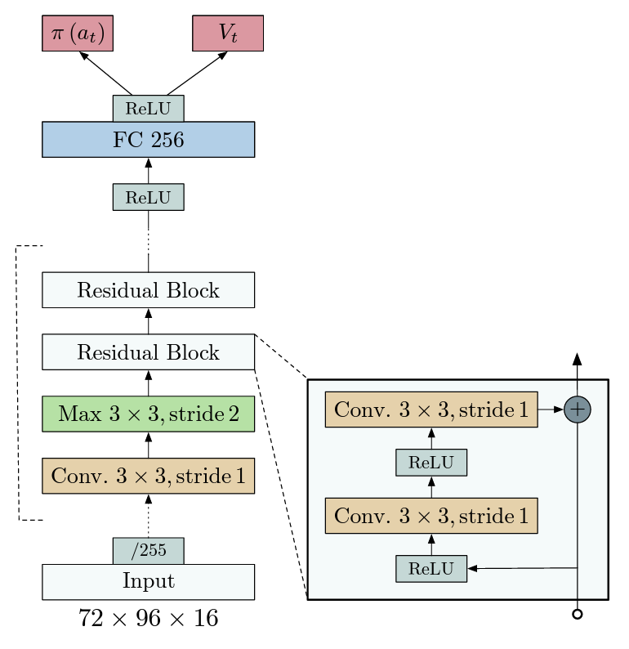
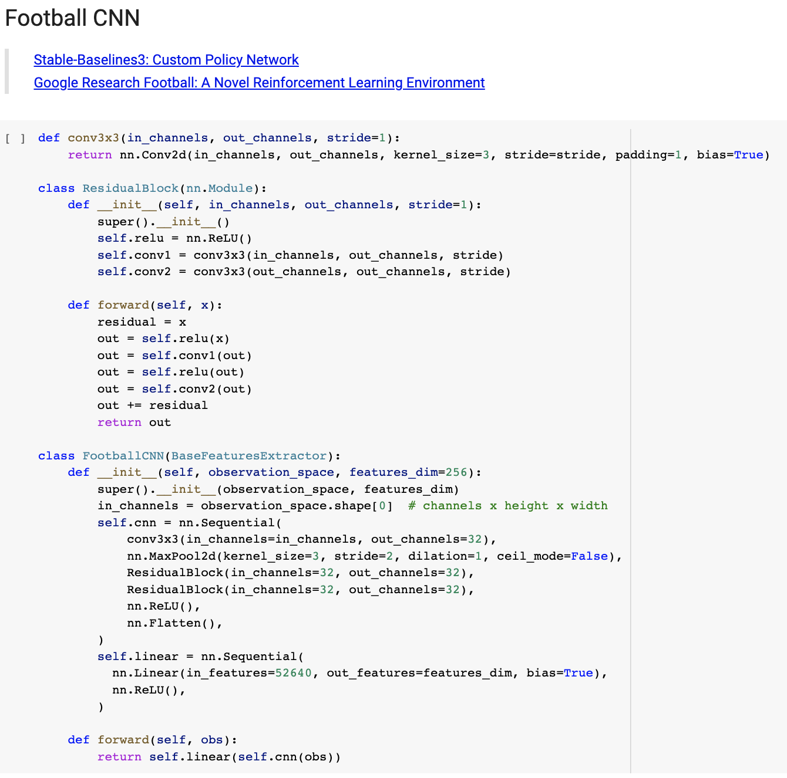
Implementation
EE488 AI Convergence Capstone Design
Custom feature extractor

Slide 14
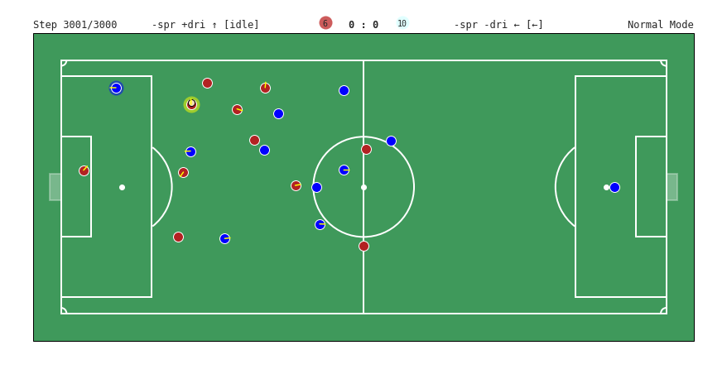
Implementation
EE488 AI Convergence Capstone Design
Action shaping
[-1, 0.42]
[0.4, 0.42]
[1, 0.42]
If opponent owns the ball or ball is loose, no shoot, pass, dribble
If my team owns the ball, no slide
Release sticky actions only if sticky actions are active
Too far, no shoot (x<0.4)
In our goal-kick, only pass available
In our corner-kick, only pass available
In our penalty-kick, only shoot available
[-1, -0.42]
[1, -0.42]

Slide 15
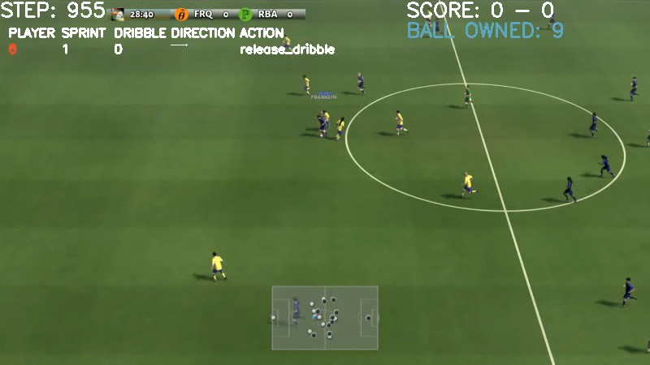
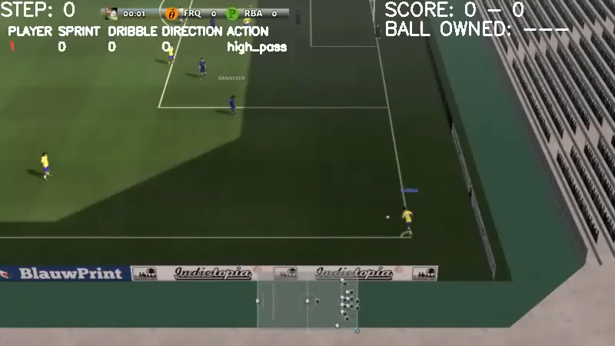
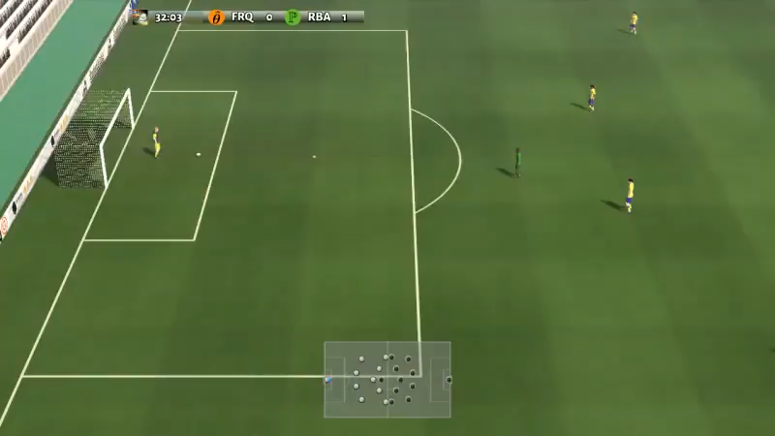
Implementation
EE488 AI Convergence Capstone Design
Action shaping
Some weird behaviors without action blocking
Not owning the ball
Corner-kick
Goal-kick

Slide 16
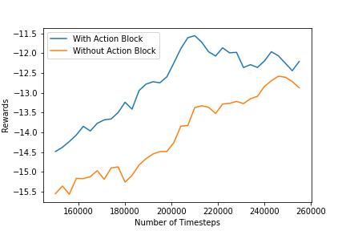
Implementation
EE488 AI Convergence Capstone Design
Action shaping
Tested in our default condition(score+core reward) vs easy opponent
Helpful for early training!

Slide 17
Implementation
EE488 AI Convergence Capstone Design
Reward shaping
Initial Idea
Zero Sum
Sum of the rewards for our agent and the opponent equal to zero
Scoring: default scoring reward*5
Checkpoint: default checkpoint reward*5
Win: +5 if game won
Ball position: divided the field into 5 zones, corresponding amount of reward given every step
- our penalty zone(-0.006)
- our zone(-0.003)
- middle(0.0)
- opponent zone(+0.003)
- opponent penalty zone(+0.006)
Yellow card: -1 for our card, +1 for opponent card
Steal: -0.01 if opponent steals the ball from our team, +0.01 if our team steals the ball from opponent
Loose ball: -0.001 if opponent gets the loose ball, +0.001 if our team gets the loose ball
Possession: -0.003 for opponent to possess the ball, +0.003 for our team to possess the ball each step

Slide 18
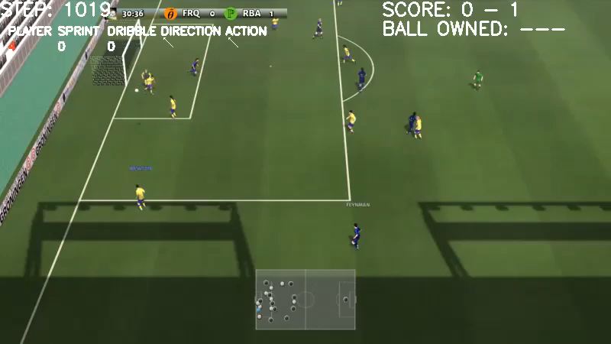
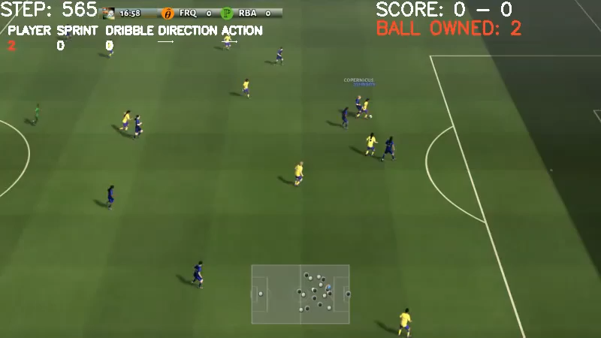
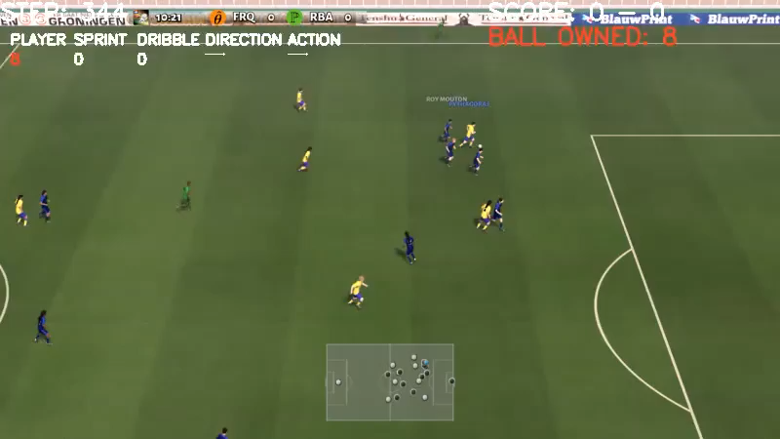
Implementation
EE488 AI Convergence Capstone Design
Reward shaping
Scoring, checkpoint, ball position, yellow card, win, steal, loose ball, possession
Scoring, checkpoint, ball position, yellow card, win
Scoring, ball position, yellow card, win
Zero-sum does not seem to work
: Zero-sum is best designed for agents in self-play mode, but our agent can only train against the default AI
: It kind of give rewards which is irrelevant to our agent action
Overfitting to certain easy-to-get reward
: It showed numerous odd behaviors seemingly because it overfits certain easy-to-get reward

Slide 19
Implementation
EE488 AI Convergence Capstone Design
Reward shaping
Overfitting reward validation
Training start
Default reward: only scoring
Modified reward: win, checkpoint, ball position, yellow card, steal, loose ball
Total of 1M timestep
Training Finish

Slide 20
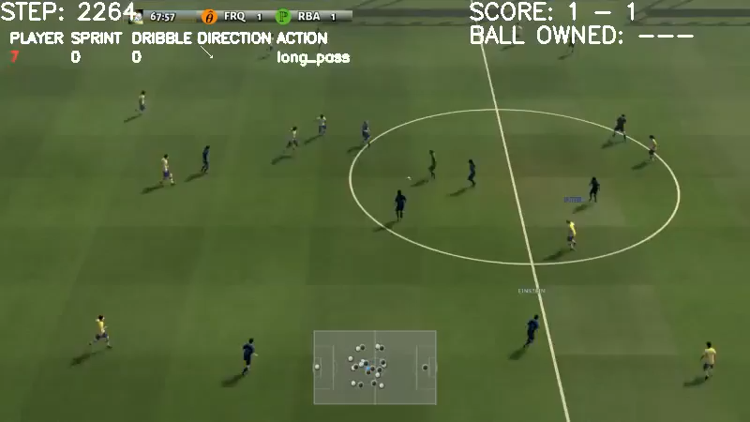
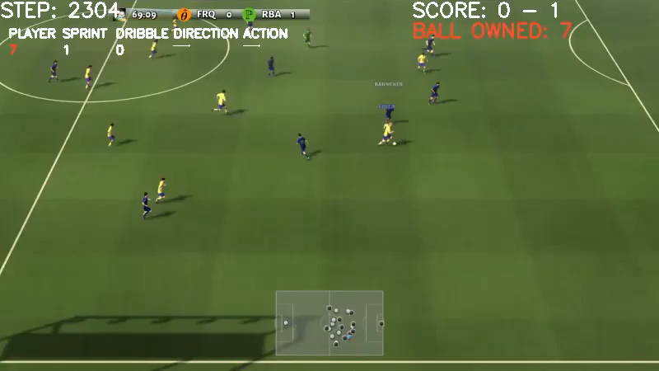
Implementation
EE488 AI Convergence Capstone Design
Reward shaping
20% modified, 80% default
80% modified, 20% default
Showed clear trend of overfitting to easy-to-get reward!

Slide 21
Implementation
EE488 AI Convergence Capstone Design
Reward shaping
Final Idea : categorizing the rewards
Core reward
Rewards for undoubtedly good/bad behaviors
Scoring
Win
Yellow card
Steal
Out of bounds
Defensive position
Shooting near opponent penalty box
Giving up corner-kick/penalty-kick

Slide 22
Implementation
EE488 AI Convergence Capstone Design
Reward shaping
Final Idea : categorizing the rewards
Non-core reward
Rewards for behaviors that is not absolutely good or bad but behaviors that we want the agent to have or not have
Divided based on the difficulty of training the agent to such behaviors
Easy reward
Medium reward
Hard reward
Ball position(without zero-sum)
Passing
Shooting from further range
Slide when in defensive position
Shooting from further range
Crossing the ball at corner-near area
To encourage to move the ball forward & pass
To encourage shooting and performing slide action when defending
To encourage shooting and crossing the ball at corner-near area

Slide 23
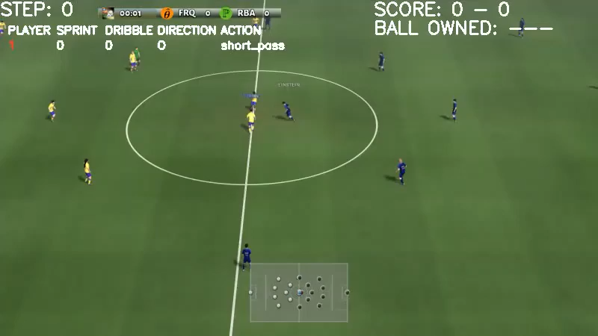
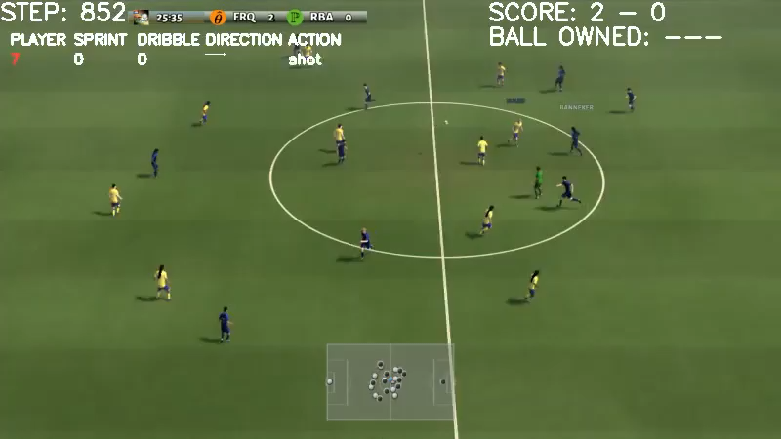
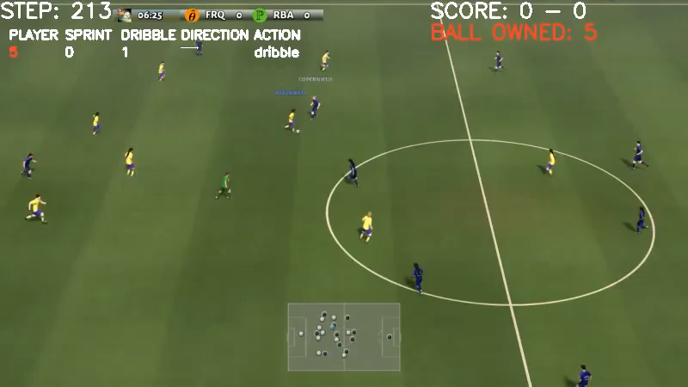
Implementation
EE488 AI Convergence Capstone Design
Training method
1. Sequential learning with reward shaping vs easy opponent
[Core+easy] reward (0.5M) → [Core+medium] reward (1.5M) → [Core+hard] reward (2M)
After [core+easy]
After [core+medium]
After [core+hard]
Shows the behavior we want to see!

Slide 24
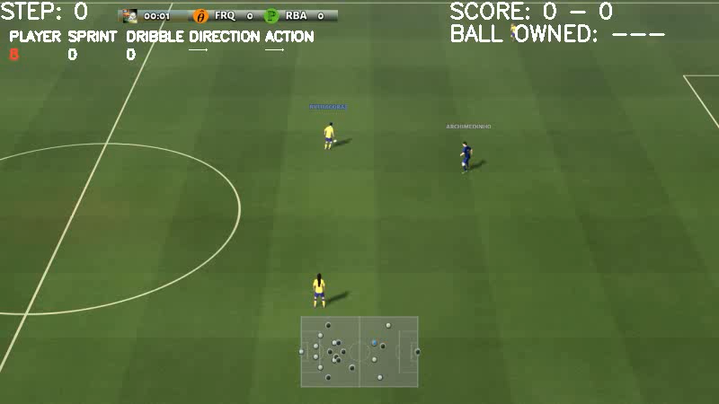
Implementation
EE488 AI Convergence Capstone Design
Training method
2. Training in specific situation to adopt tactical movement
It was hard for agent to show tactical movements in football just by training in 11 vs 11 environment
We trained the agent in a specific situation to learn how to behave in that strategical moment
Football academy : Easy counter-attack
4 versus 1 counter-attack with keeper; all the remaining players of both teams run back towards the ball
Trained for additional 1M timestep
Expected to make the agent more aggressive in the offensive end

Slide 25
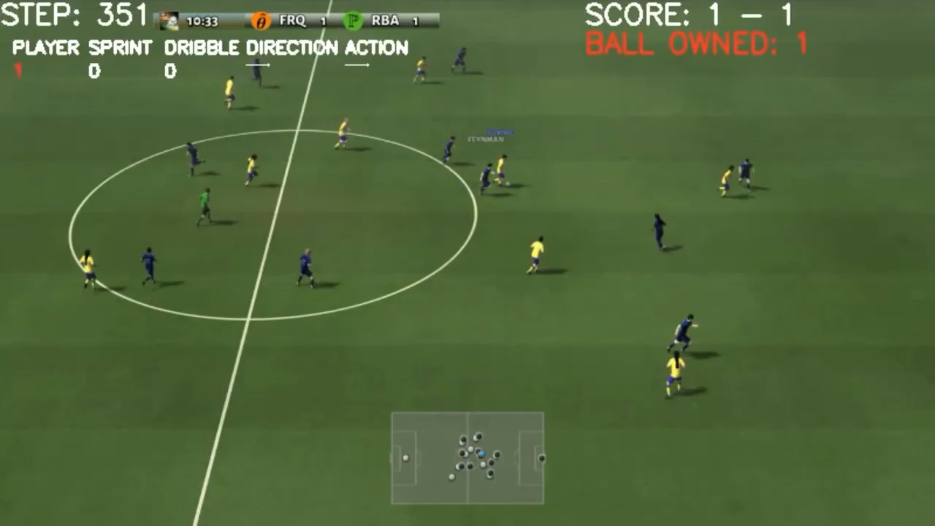
Results
EE488 AI Convergence Capstone Design

Slide 26
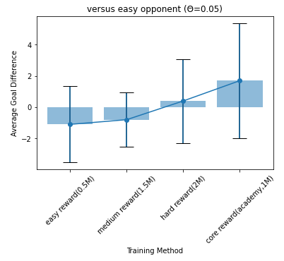
Results
EE488 AI Convergence Capstone Design
Validation after each training process ended vs easy opponent(10 games)
Clearly shows the improvement!

Slide 27
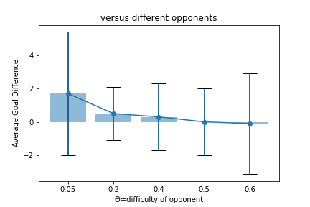
Results
EE488 AI Convergence Capstone Design
Validation versus various opponents(10 games)
Great performance after only 5M timestep!

Slide 28
Results
EE488 AI Convergence Capstone Design
Our final result showed
Our strategy was on-point
Great performance even in short timestep
Future training guideline
Meaningful final-project!

Slide 29


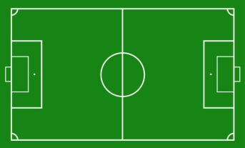
Limitation
EE488 AI Convergence Capstone Design
Limitations/Difficulties
Computational
Technical
The Environment
Lack of training time
1M steps take a day
Research paper also shows performances after 20M steps
No base code
With SB3, cannot try self-play, multi-agent
Each position has a different role but share the same policy
A goal is resulted by various complicated strategies
Difficult to induce a certain behavior with a certain reward
Low sample efficiency

Slide 30

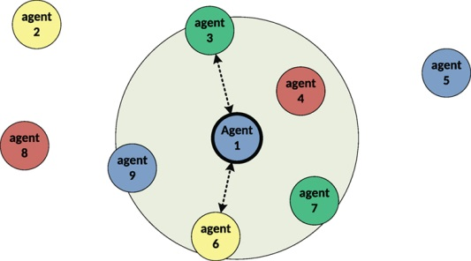

Follow-up
EE488 AI Convergence Capstone Design
Next Steps
Imitation Learning
Self-Play
Multi Agent
Using supervised learning with advanced football gameplays to initially train a model
Training against an agent of same skills, utilizing Zero-sum reward
Players of each position in an actual football game have different strategies
=> Giving each player a separate policy

Slide 31
Acknowledgement
EE488 AI Convergence Capstone Design
Google Research Football: A Novel Reinforcement Learning Environment
Karol Kurach, Anton Raichuk, Piotr Stańczyk, Michał Zając, Olivier Bachem, Lasse Espeholt, Carlos Riquelme, Damien Vincent, Marcin Michalski, Olivier Bousquet, Sylvain Gelly (2020). arXiv:1907.11180
Google Research Football open-source code in Github
https://github.com/google-research/football
Google Research Football AI Blog
https://ai.googleblog.com/2019/06/introducing-google-research-football.html
Google Research Football with Manchester City F.C. (Kaggle)
https://www.kaggle.com/competitions/google-football/overview
Kaggle Participants
https://www.kaggle.com/code/kwabenantim/gfootball-stable-baselines3/notebook
https://www.kaggle.com/competitions/google-football/discussion/201376
https://www.kaggle.com/competitions/google-football/discussion/200709
https://flyyufelix.github.io/2020/12/02/google-football-rl.html
https://sites.google.com/view/rl-football/
https://www.youtube.com/watch?v=MmVcdfeRYD8
https://github.com/seungeunrho/football-paris

Slide 32
Thank you
Logout
Copyright ⓒ D.sual 2017. All Rights Reserved

